Slide 1
BrightTv Case study
Presentation by Thizwikoni Mposhomali
May 2025

Slide 2
Agenda
Executive summary
Project objective
Analysis
Recommendations

Slide 3
Executive Summary
Two data files were provided for BrightTV Case Study. These files are User profile and Viewership. These files contain subscriber profiles as well as viewership information.
Data was collected for the period 01/01/2016 to 31/03/2016.
It was found that the unique users were 5376.
Gauteng province has a higher number of viewers

Slide 4
Aim and Objective
AIM
To provide insights that would assist CVM (Customer Value
Management) team in meeting this year’s objective.
OBJECTIVE
To grow the company’s subscription base for this financial
year

Slide 5
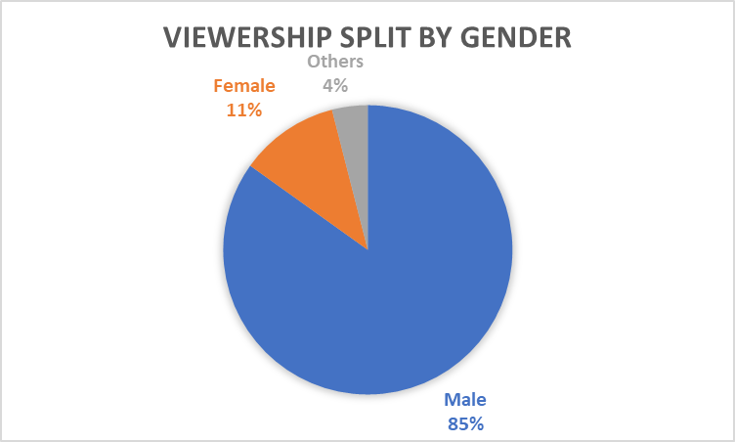
Analysis
Higher number of viewers are male which is 83%
4% of people did not provide details

Slide 6
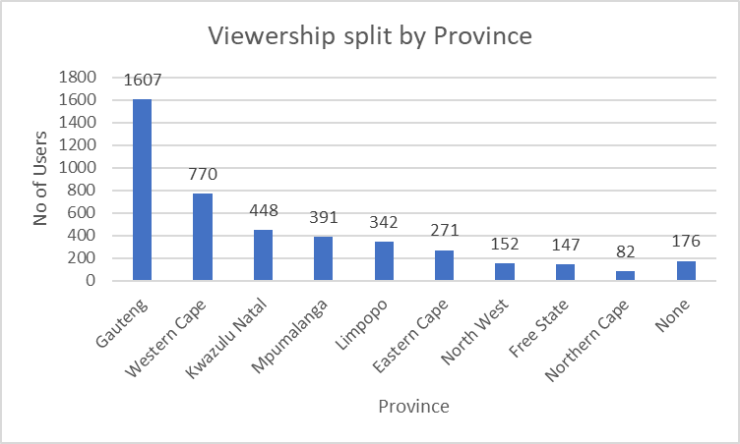
Viewership by Province

Slide 7
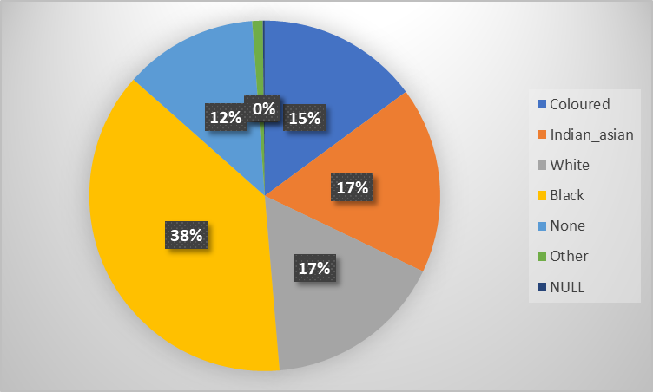
Viewership by race

Slide 8
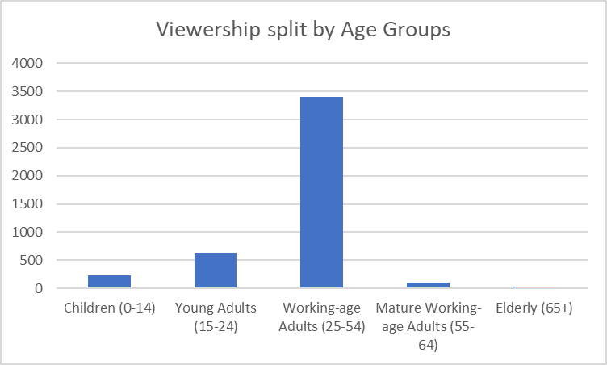
Viewership by age group

Slide 9
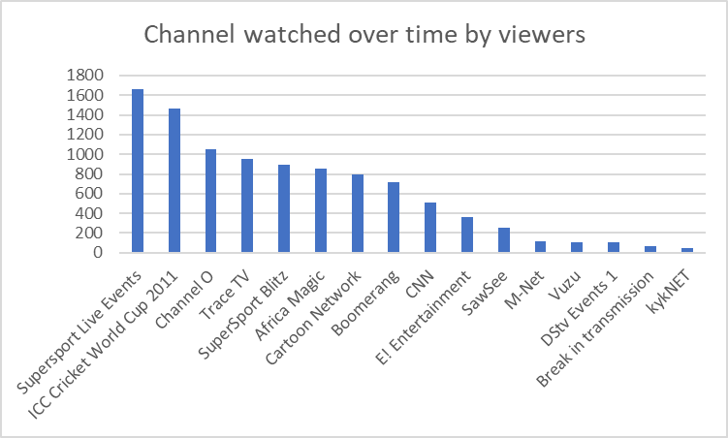
Most watched channels
The most watched channel is Supersport Live Events with 1661 views and it watched by males

Slide 10
Factors influencing consumption
Affordability and Cost - When subscription costs increases, it becomes less affordable for some consumers, particularly those in lower-income households.
Content and Programming - Content offering sports, movies, news and local content, attracts viewers.
Location - In rural areas, news programming is more popular than movies, while in urban areas, movies are more frequently watched.
Loadshedding - Periods of loadshedding can have a negative impact on Bright TV viewership
Social interactions and recommendations can also influence viewing choices.
Age - Younger generations are more likely to use streaming services compared to older demographics who may prefer traditional TV.

Slide 11
Recommendations
Prioritise channels that people watch e.g. content offering sports, movies, news and local content, attracts viewers.
Do outreach programmes in rural areas about BrightTv and go with different actors
Evolve with time
Quality content over quantity
Create a new model (pay as you watch) that can track what people like

Slide 12
Recommendations continuation
Create a package which allows people to watch what they like, the package must be aligned to the trend, must be tailored for specific audience from the of channels available
Relook the way to come up with the packages
BrightTv must offer Rewards such as, but not limited to, vouchers, exclusive access to VIP events, early-bird access to tickets, package upgrades and discount offers

